Slide 1





Capstone Project Phase A
Securing Medical Institutes Data,
Encryption using E-ART Algorithm.
Students:
Ahmad Haj
Wael Hamada
Supervisor: Reuven Cohen

Slide 2

Content
The Problem
Our Solution
Encryption – DES AES
E-ART
Testing
Product Attributes
Developing Tools
GUI
Diagrams
Challenges And Expectation
Conclusion

Slide 3

THE PROBLEM
One of every 60 Israeli organizations is targeted every week with ransomware attacks
Medical institutions are one of the most targeted sectors
These institutes store sensitive medical data
Existing solutions require long execution times and great memory consumption

Slide 4

Our solution
Security application using E-ART algorithm for securing medical data.
Secured data management.
Robust application with an easy-to-use interface.
Back up on cloud.

Slide 5
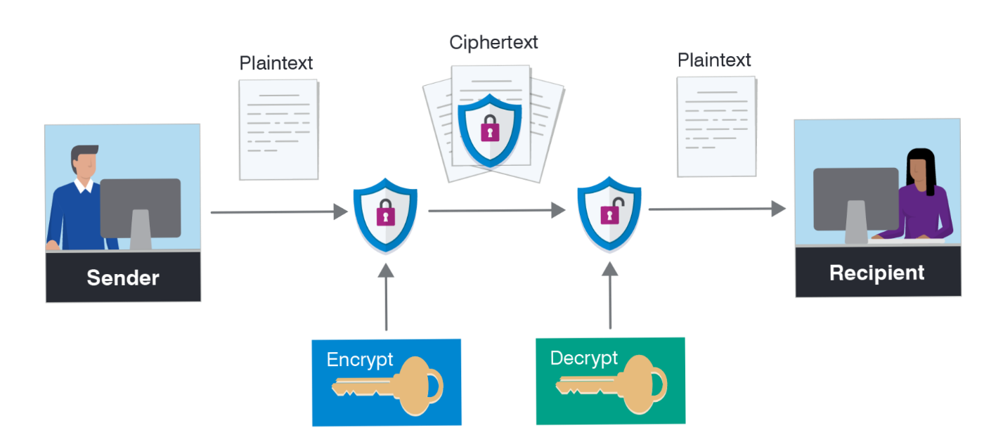
encryption
Encryption is the process of encoding an information that only authorized parties can access it
Encryption uses an algorithm to encrypt data
The receiving party then uses a key to decrypt.

Slide 6

Encryption
Common encryption algorithms:
DES
Block cipher.
Same algorithm and key for encryption decryption.
Vulnerable to brute-force attacks.
AES
Block cipher.
Different key lengths 128, 192, and 256.
Sufficient to protect classified information.
Commonly used today.

Slide 7

E-ART
E-ART is new, efficient, flexible, and secure algorithm.
Adopts the dynamic key concept.
Using a balanced binary search tree data structure.
128-bit symmetric key.

Slide 8
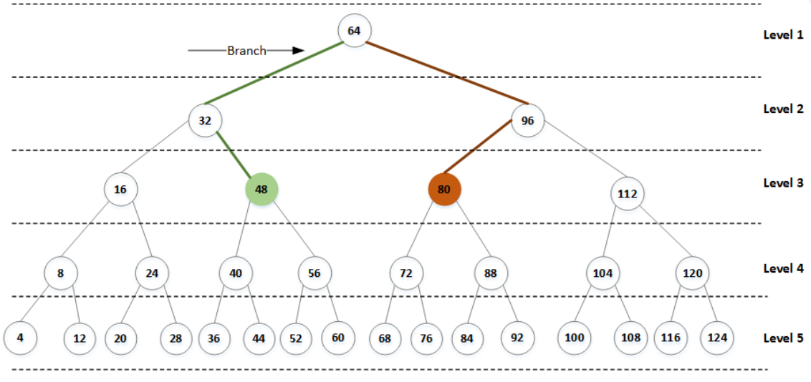
E-art structure
Proposing the use of the reflection property of a balanced binary tree data structure.

Slide 9

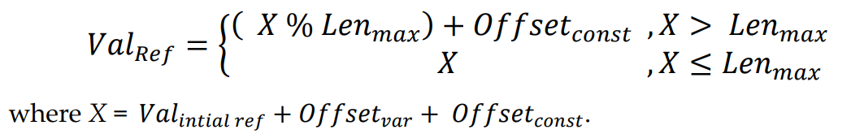
E-art structure
Some issues with the initial reflected value:
Characters that range from 0 to 32 in the ASCII are not addressed.
It is vulnerable to cryptanalysis attacks, duo to one-to-one mapping of characters.
The addition of multiple offsets to the initial reflected value.

Slide 10
E-art structure
Key derivation:
Two offsets which are constructed from the initial key.
First offset called the variable offset.
Second offset is a dynamic one.
Initial key:
Consists of two parameters, N-key and Variance.
Both are used to generate the offsets.

Slide 11

ALGORITHM TESTSING
E-ART’s performance and efficiency evaluation will be done by checking the following criteria:
The avalanche effect
Frequency analysis
Performance analysis
Randomness Verification – NIST() suit

Slide 12
Software testing
Test ID | Description | Expected result | Actual result
1.a | User enters correct username and password. | System recognizes the User's data and opens his main window.
1.b | User enters incorrect username or incorrect password. | User is Not recognized, and system will display error window.
2.a | Doctors insert new patient data to add him to the system. | Adding this patient to the system and system will display confirmation window
2.b | Doctors insert existing data of patient to add him to the system. | The system will display error window.
4.a | Doctor with permission "A" Search patient's Files. | The System will display asked data.
4.b | Doctor with permission "B" Search patient's Files. | The system will display error window.

Slide 13

PRODUCT attributes
High level of security when dealing with big data
Decent encryption time
Light on resources
Easy-to-use application interface

Slide 14



DEVELOPING TOOLS

Slide 15
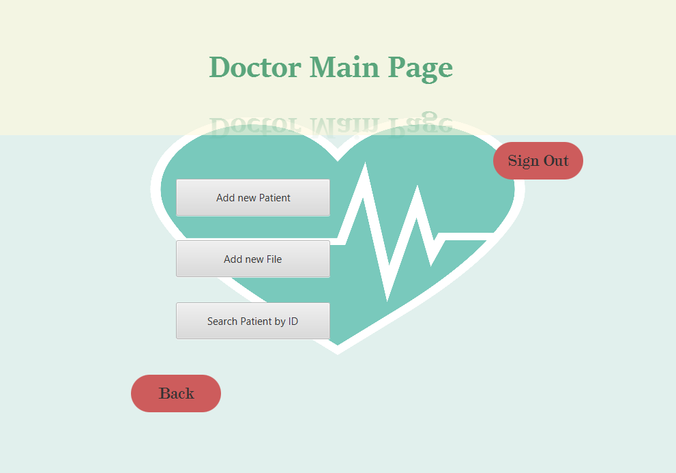
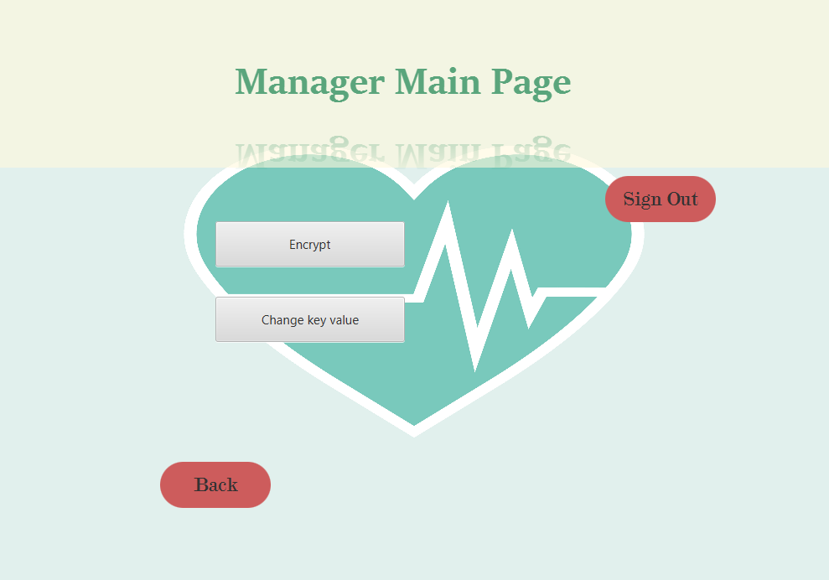
GUI

Slide 16
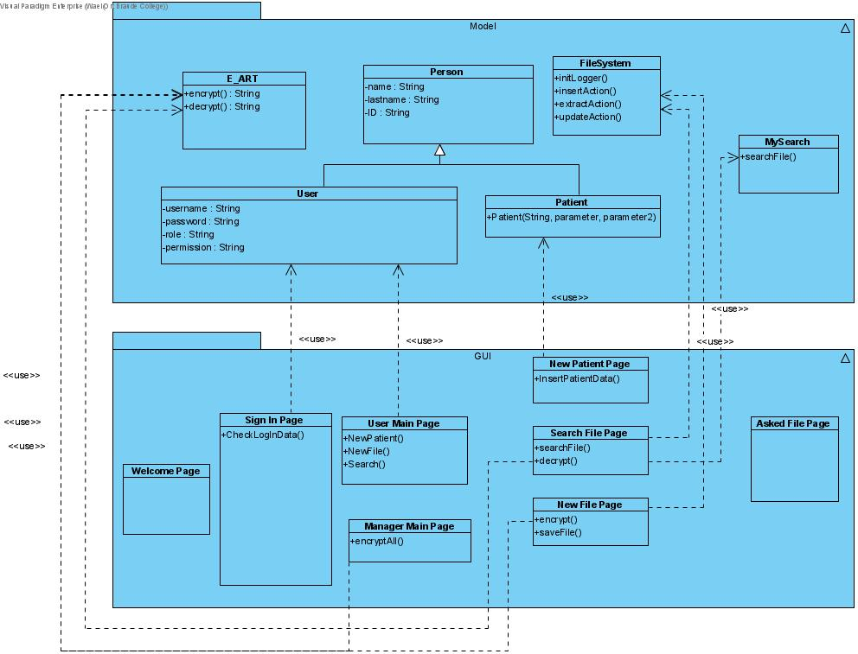
Class diagram

Slide 17
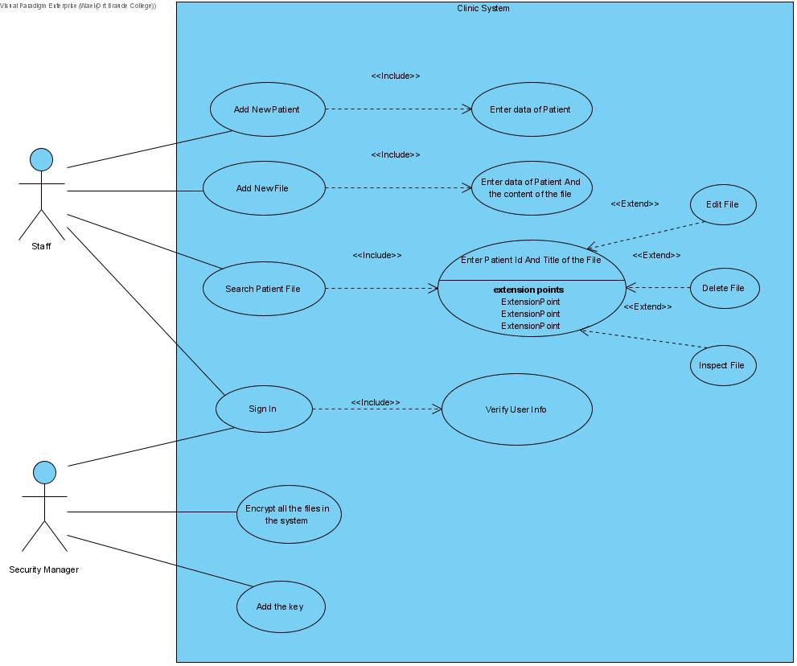
USE CASE DIAGRAM

Slide 18

Challenges
Challenges:
Dataset collecting
Efficient algorithm
Efficient testing
High security level

Slide 19

expectation
Both the system and the algorithm are expected to pass the planned test.
The following the expected:
High level of security
Light on resources
Good encryption performance

Slide 20

Conclusion
We learned how to apply our knowledge and experience in cryptography into the project idea.
Diving deep into the internet, reading a lot about cybersecurity.
Gaining experience of how to prepare for big projects step by step.
We are looking forward for the implementation phase.

Slide 21


